Slide 1


IM3080 DESIGN AND INNOVATION PROJECT
FLOWERSCENT
By Group 7

Slide 2
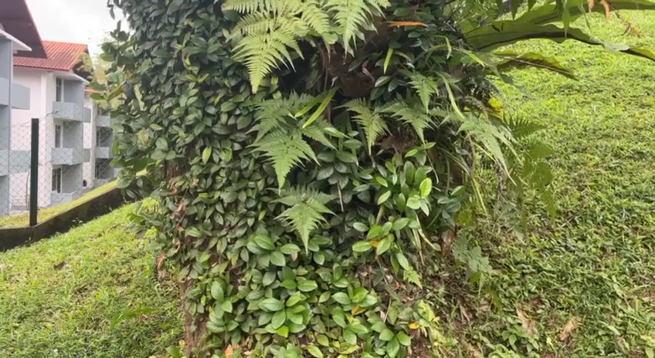
INTRODUCTION VIDEO

Slide 3
Topics of Discussion
INTRODUCTION
DESIGN
SOUND
LIGHT
CONCLUSION
Background & Objectives
Ideation
Process
Final
Ideation
Tools
Setup
Master-Slave
Visual Effects
Future Work
Flowerscent

Slide 4

INTRODUCTION
BACKGROUND
Plastic pollution is one of the rising global problems
Main cause of pollution is littering
Food wrapping
Plastic bags
Bottles
Plastic is NON-BIODEGRADABLE
It takes about 450 years
Flowerscent

Slide 5

INTRODUCTION
BACKGROUND
Pollution can alter
Animal habitats
Natural processes
Reducing ecosystem ability to adapt climate changes
Flowerscent

Slide 6
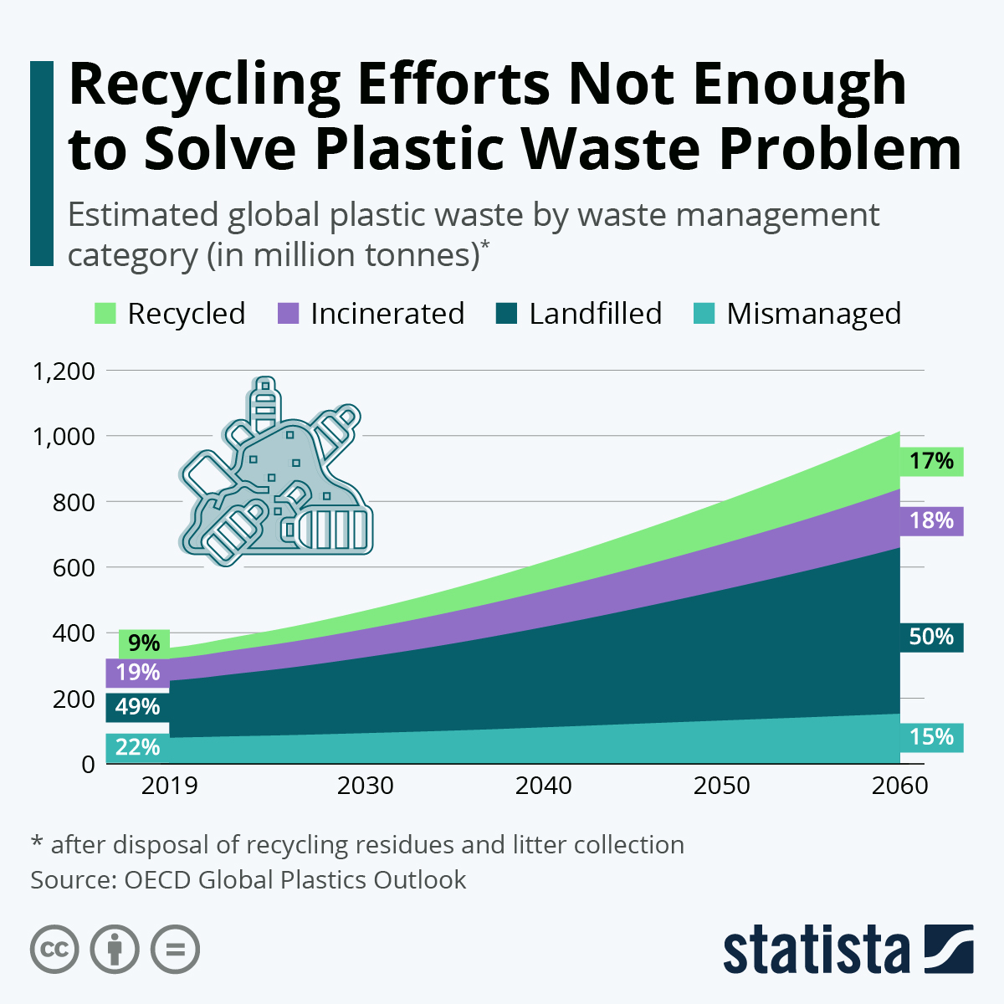


Slide 7
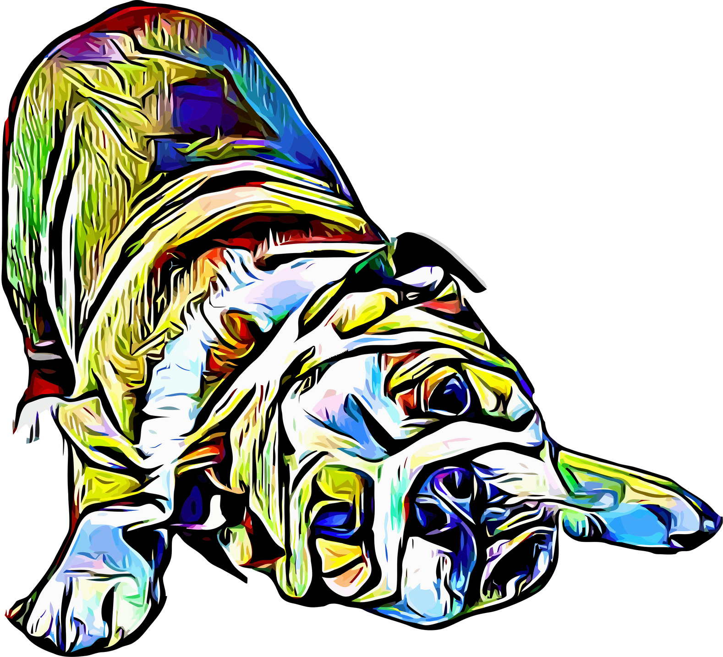
Objectives
To design artwork and improve the project with energy-saving lighting, ambient nature sounds and environmentally friendly materials.
Adding additional features to the project such as different light and sound effects
Encourage and remind general public to adopt sustainable habits
Raise awareness of the harmful effect of plastic pollution and educate the need to reuse and recycle

Slide 8


DESIGN

Slide 9
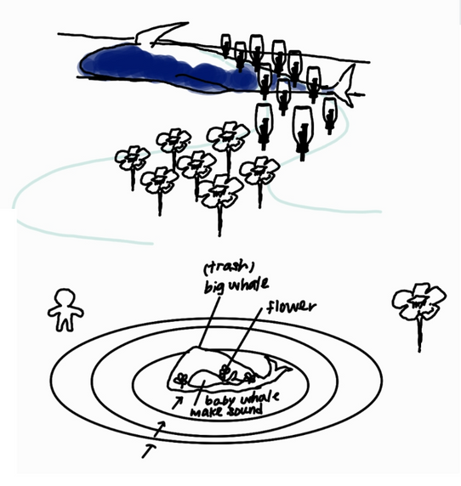
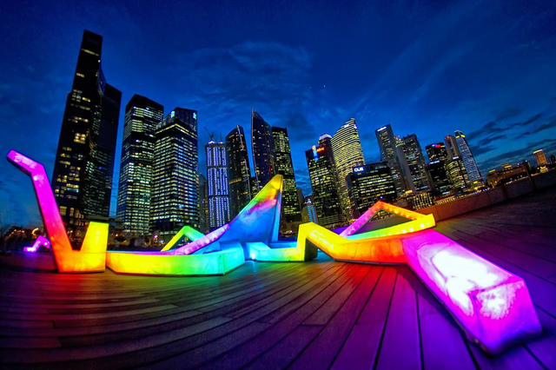
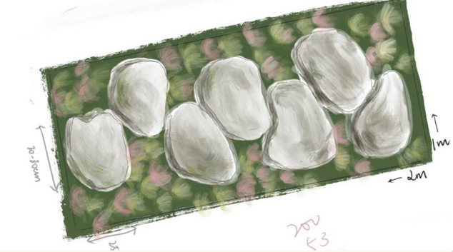
Ideation
Main concept
WALKWAY
INTERACTION
EDUCATIONAL
Need to be long enough to create an effect
Incorporating games/action
Plastic pollution

Slide 10
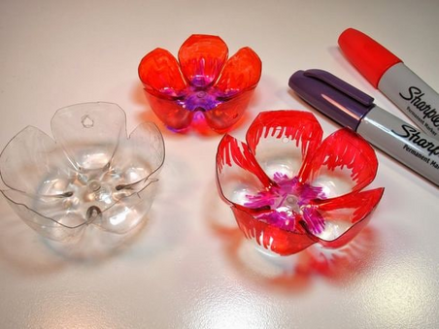
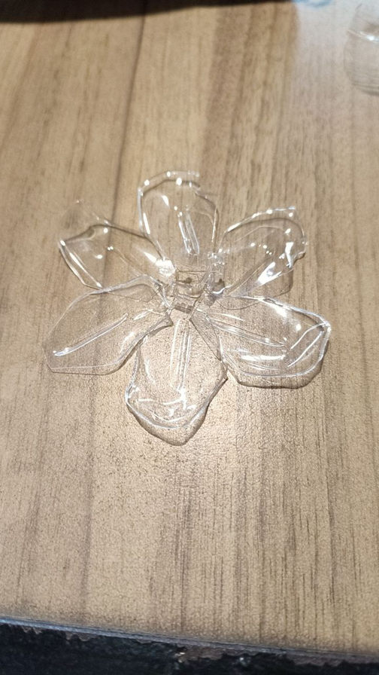
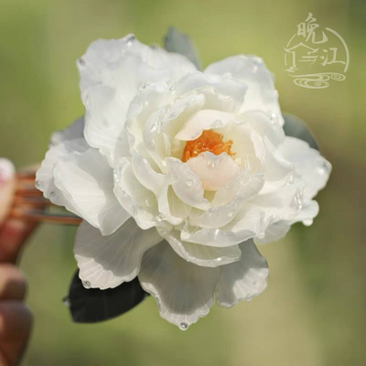
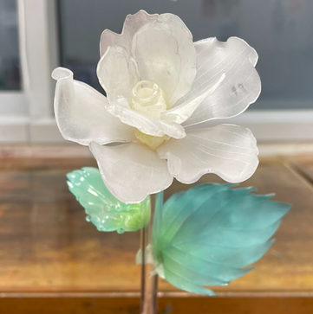
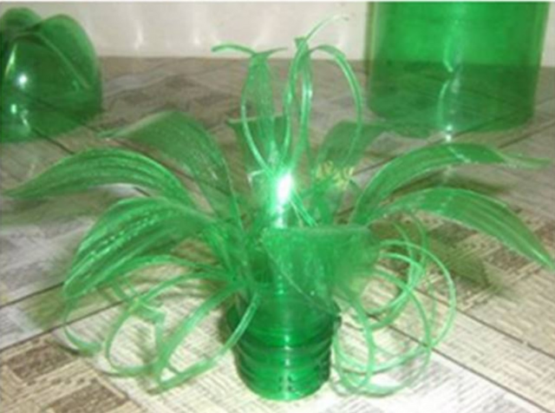
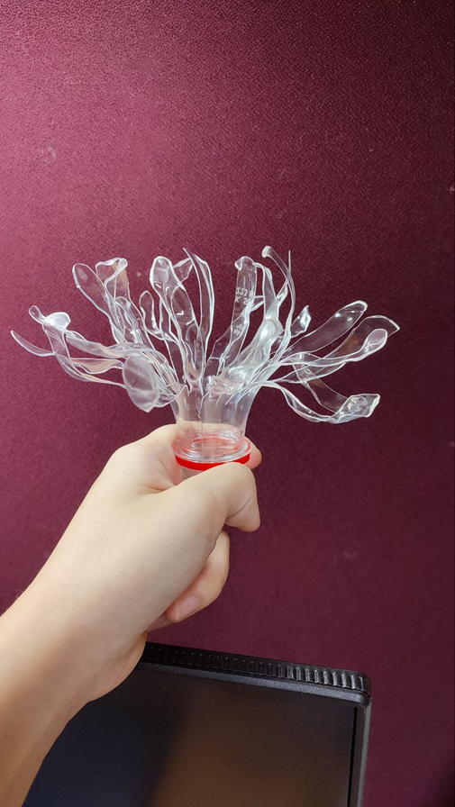
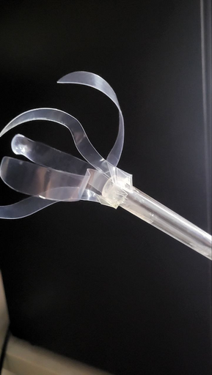
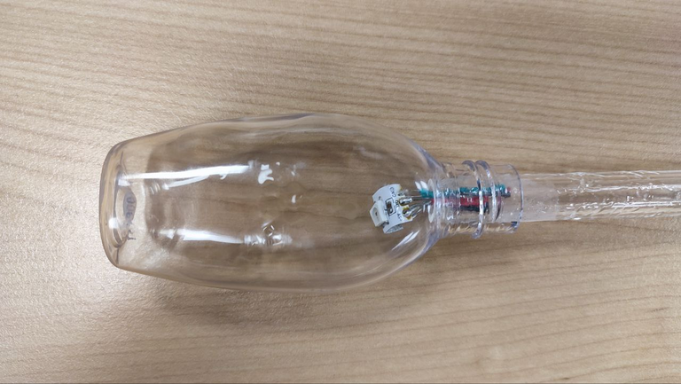
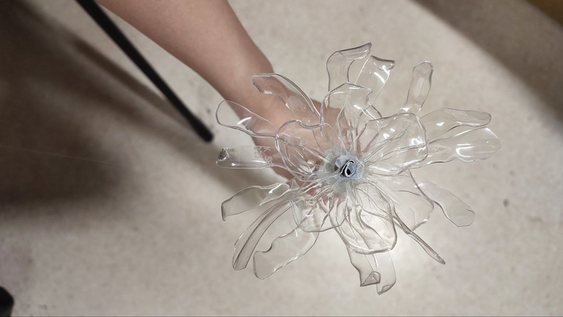
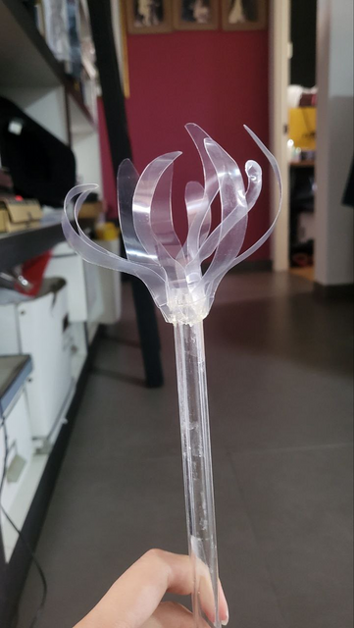
Ideation
Flower Prototype

Slide 11
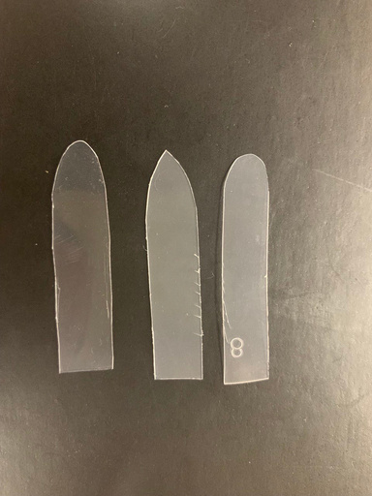
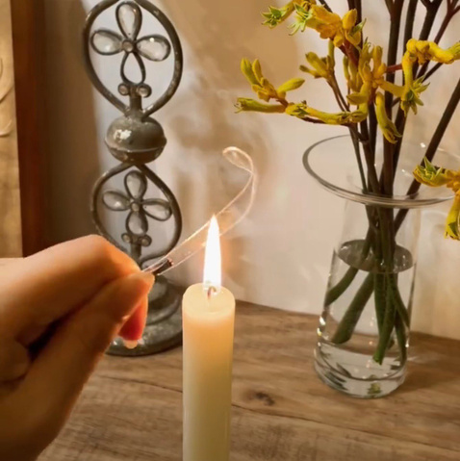
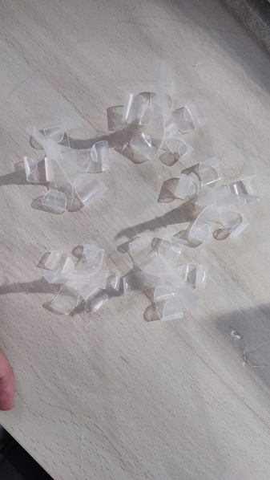
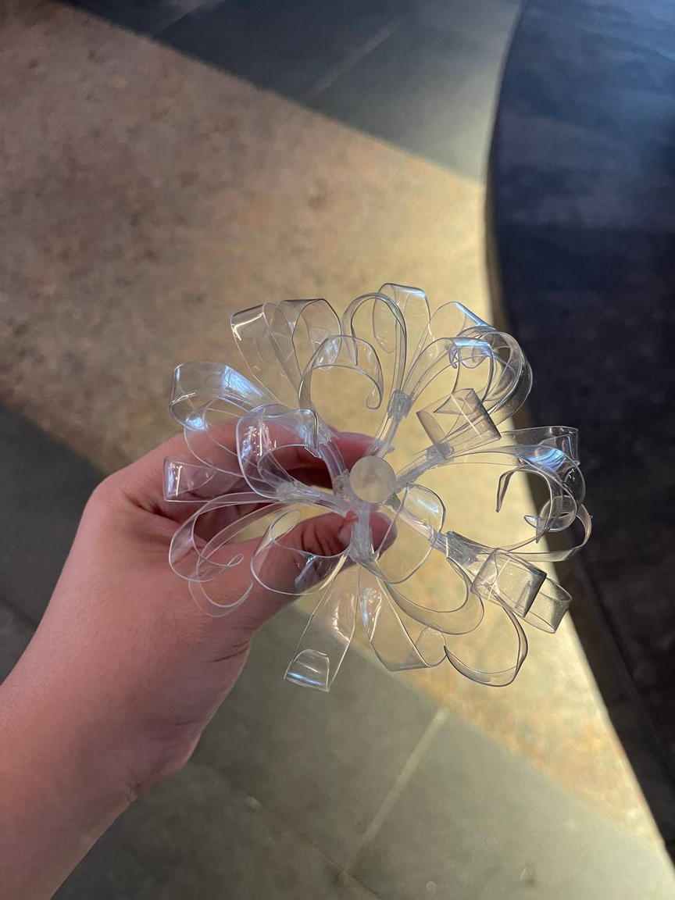
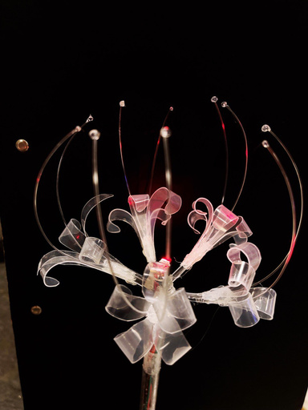





Process
(Finalised flower)
Each flower is made up of 5 mini flowers which is made up of 5 pedals
Cut out all petals (40flowers x 25petals = 1000 petals)
Heat up all petals evenly and curl the front and trim the bottom into a v-shape
Paste 5 petals onto a mini stick to make a small flower
Paste 5 small flowers onto the tube to make a big flower
Hot glue a small glue dot onto one end of the fishing line to recreate the anther of the stamen and stick 2 stamens onto every small flower. Each flower has 10 stamens in total to create an even dome shape.

Slide 12
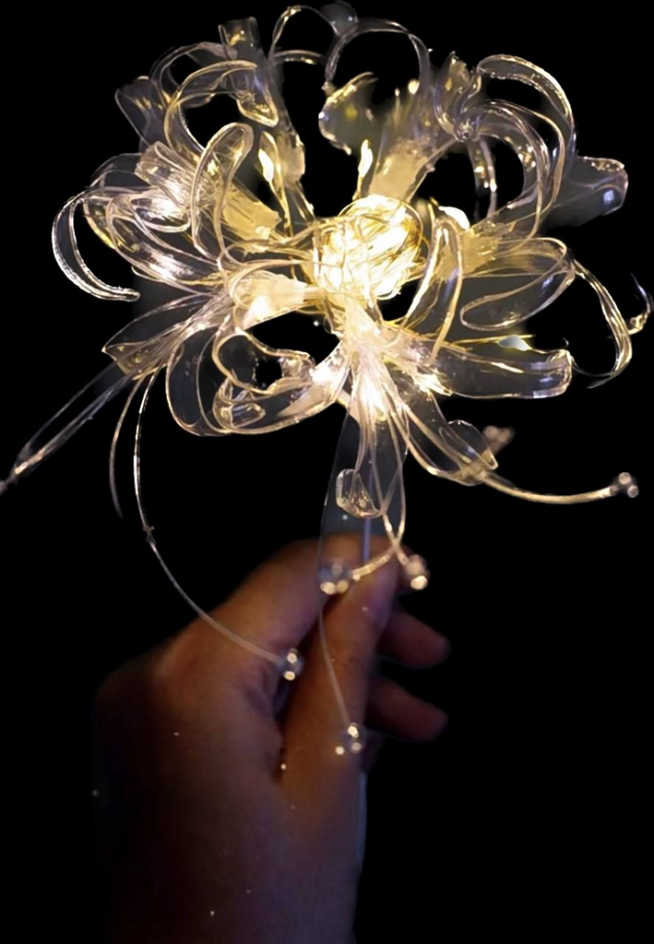
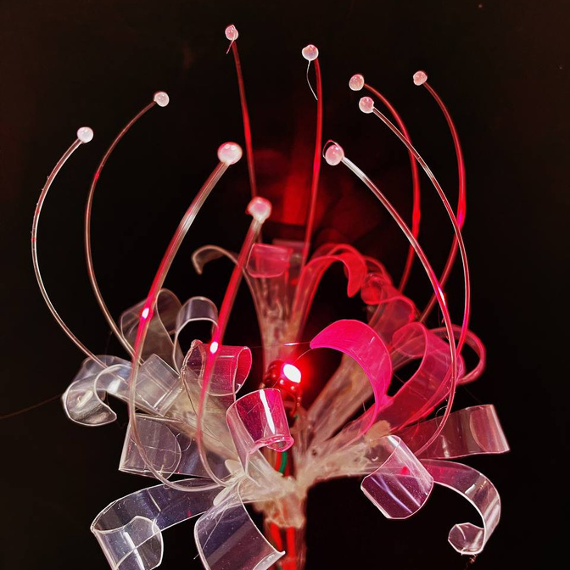
Finalised Flower
Each flower is made up of 5 stalks of 5 petals

Slide 13
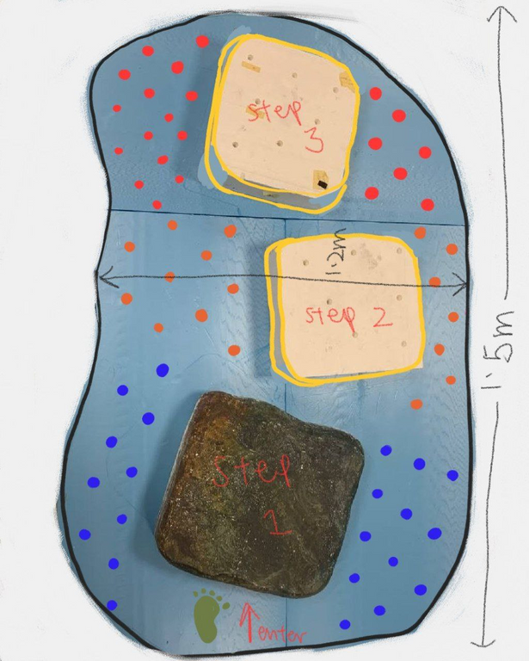
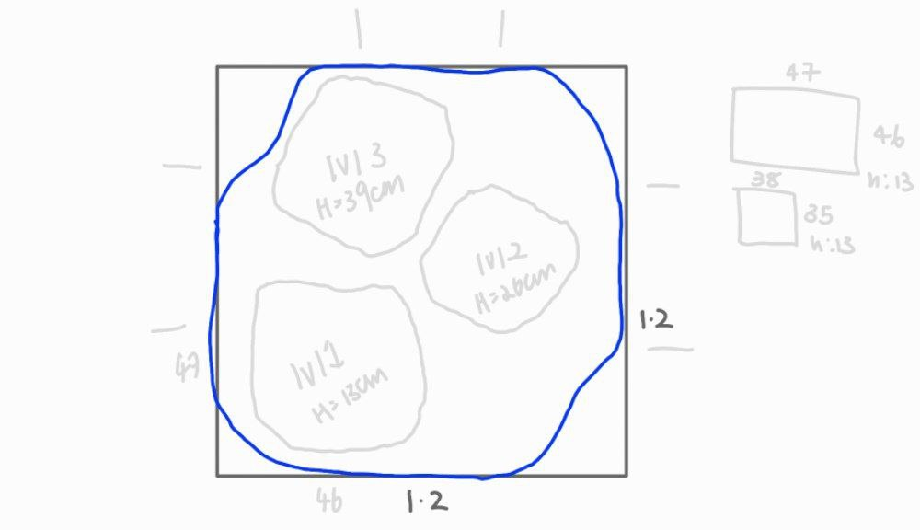
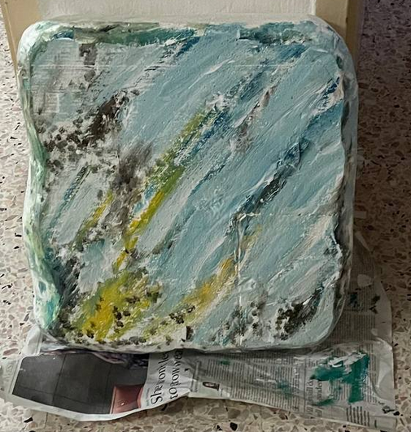
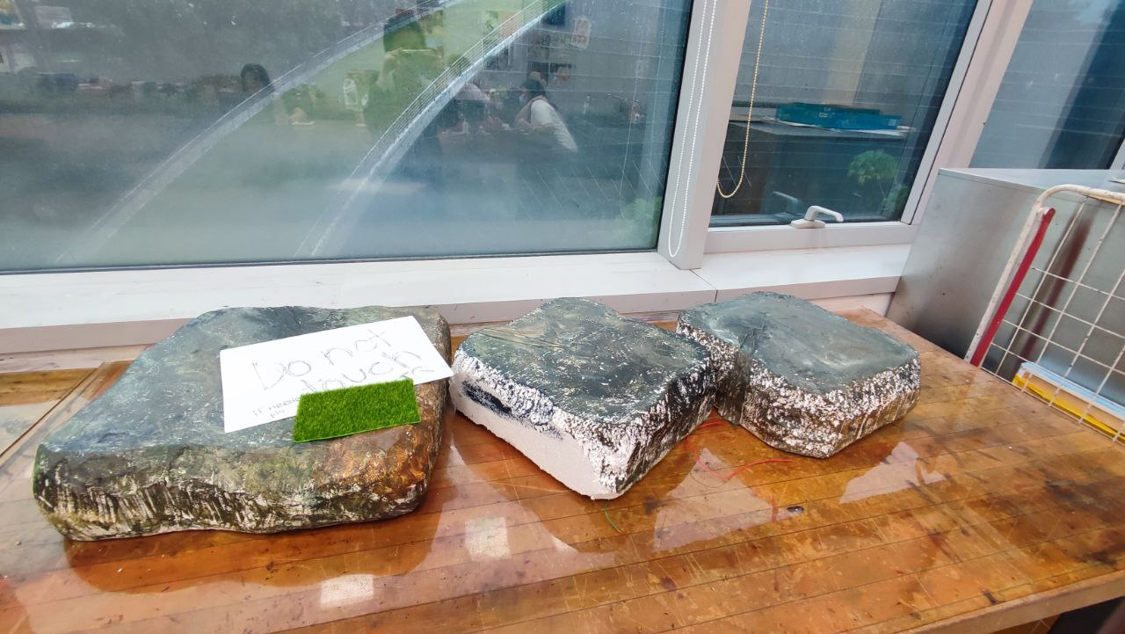
Ideation
Base & steps

Slide 14

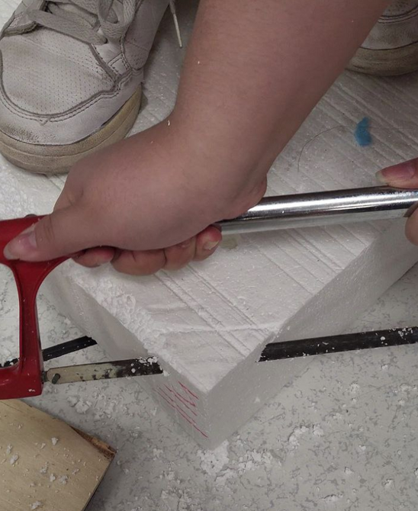
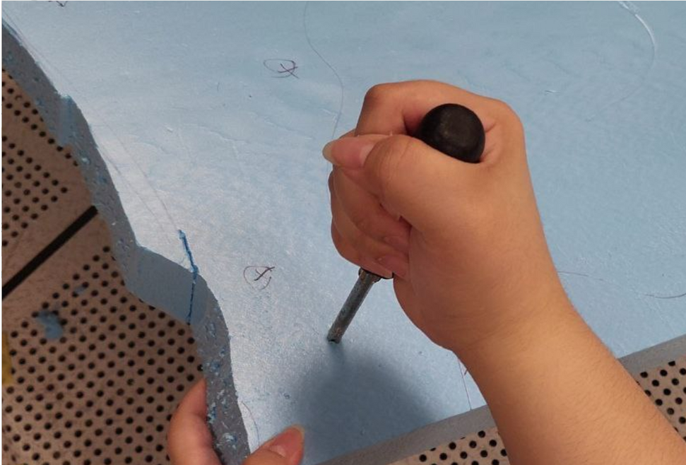
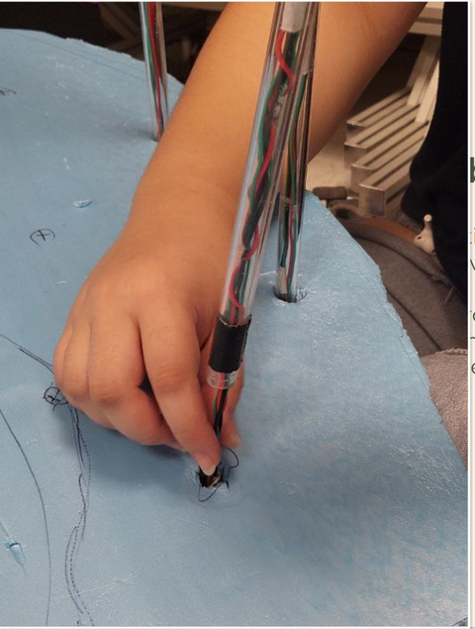
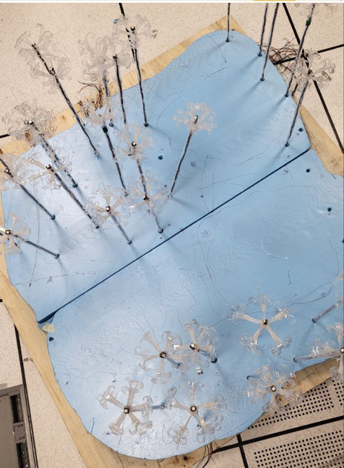
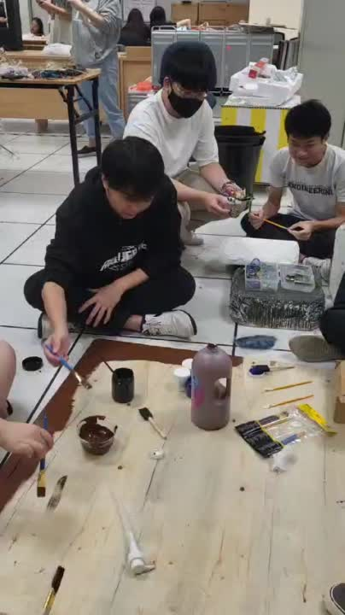
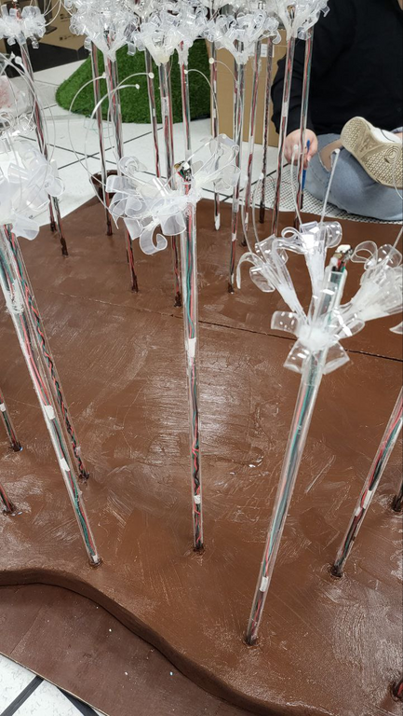
Process
Base & steps

Slide 15
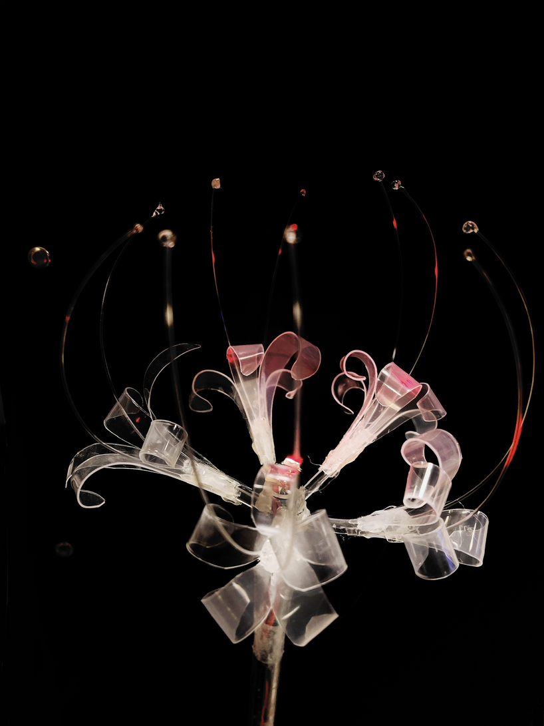
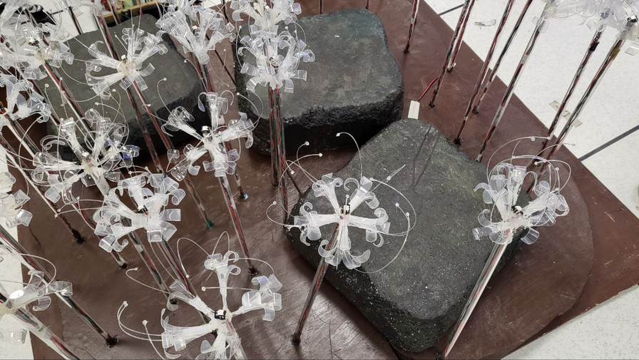
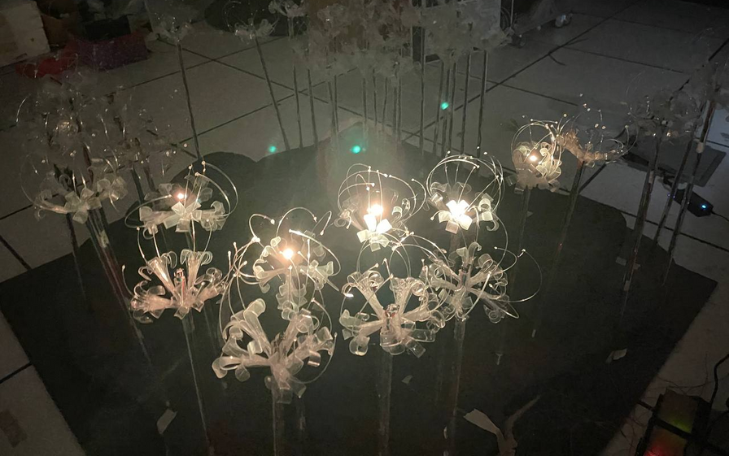
Final Design

Slide 16
SOUND

Slide 17
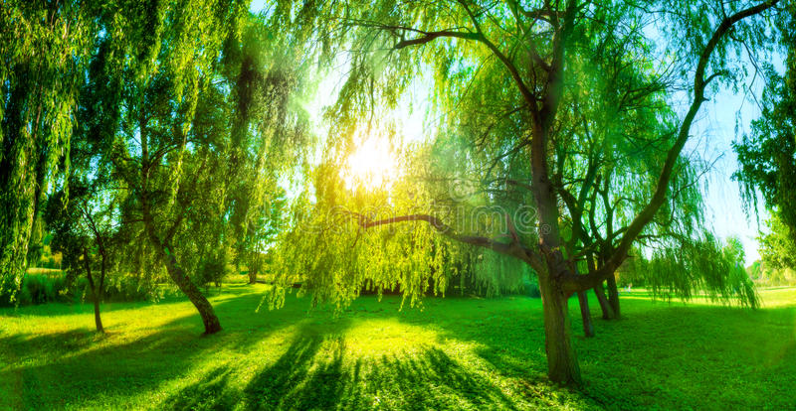
Ideation
MAIN CONCEPT
Nature theme

Slide 18
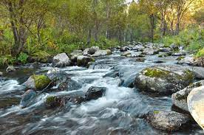
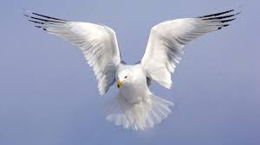
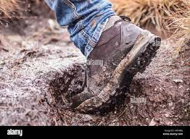
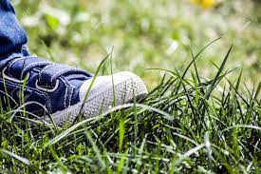
Sound Chosen
RIVER
FLAPPING
MUD
GRASS
BGM
STEP 1
STEP 2
STEP 3

Slide 19

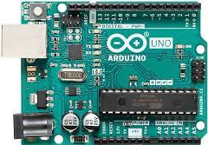
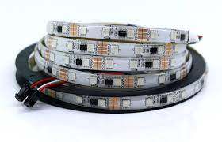
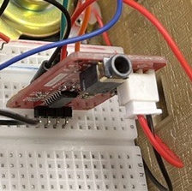
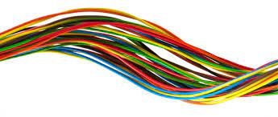
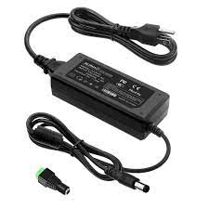
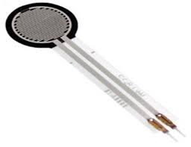
Components
Adruino Unos
WS2811 LED Strips
Serial MP3 Player Module (UART)
Wires
Pressure Sensors
5V Power supply

Slide 20
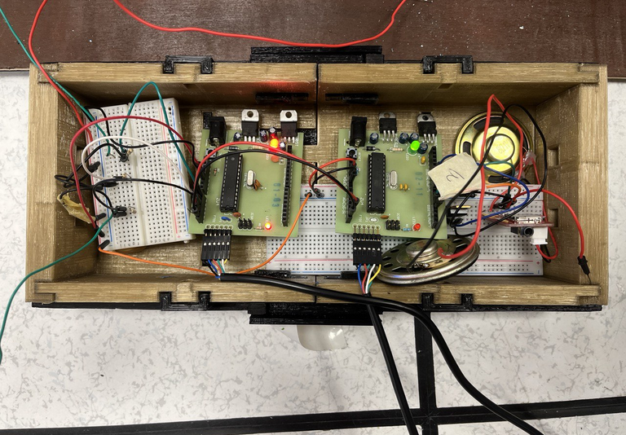
Overall Sound Setup
Pressure sensor 1
PCM
Speaker
Steps
Pressure sensor 2
Adruino A
Adruino B
UART
Speaker
BGM
Pressure sensor 3

Slide 21
LIGHT

Slide 22

MASTER SYSTEM
SLAVE SYSTEM
Combines visual and audio works
Optimizing I/O through workload distribution
Enhances performance as actions are processed in parallel

Slide 23
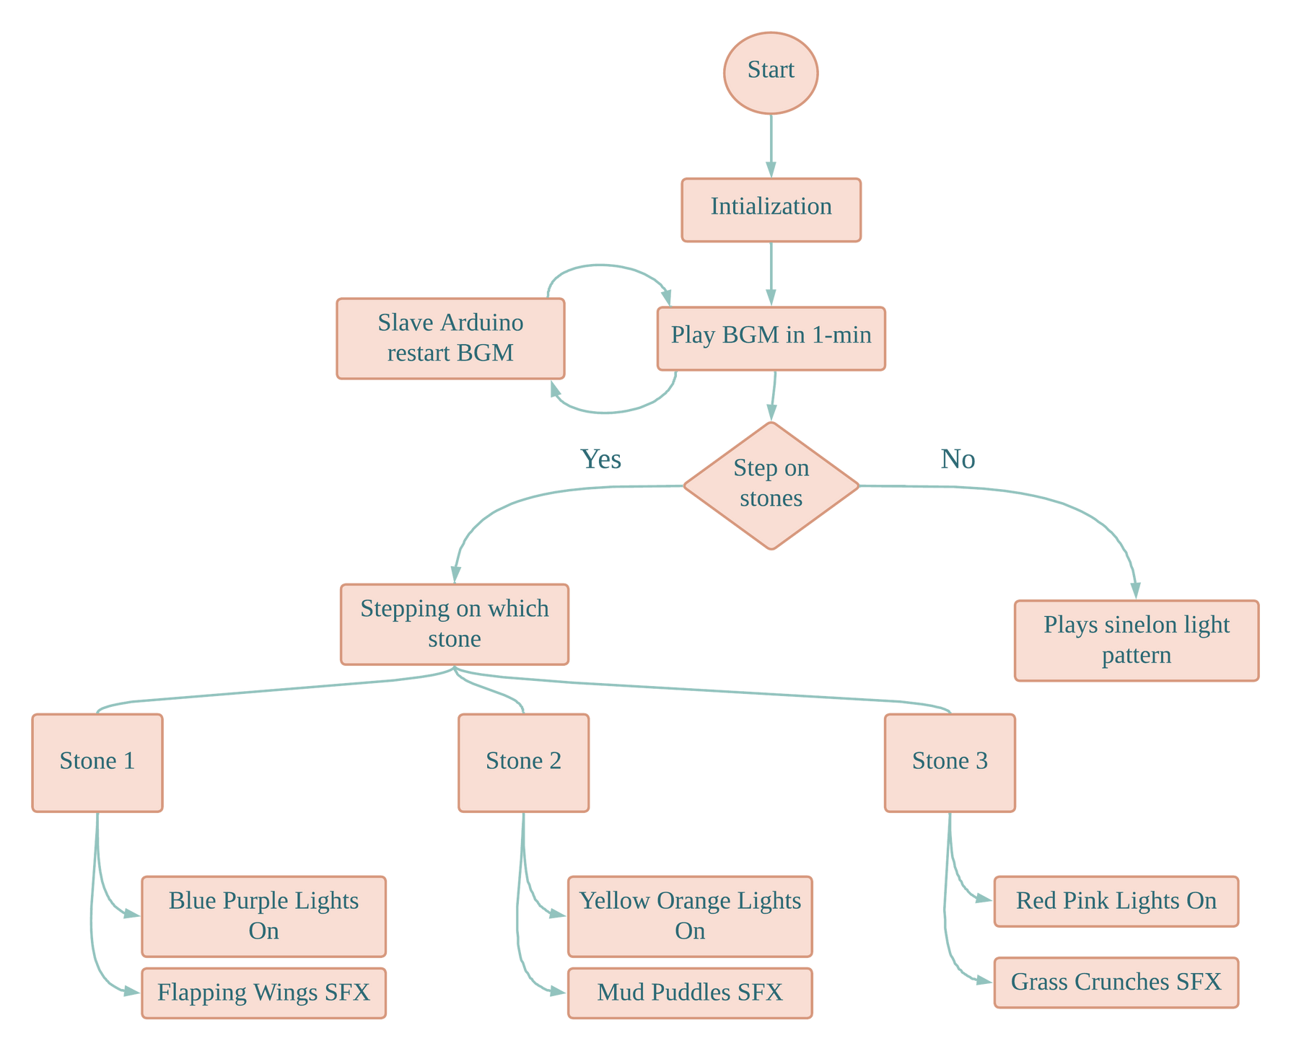
BLOCK DIAGRAM OF HOW FLOWERESCENT WORKS
Yes
No

Slide 24
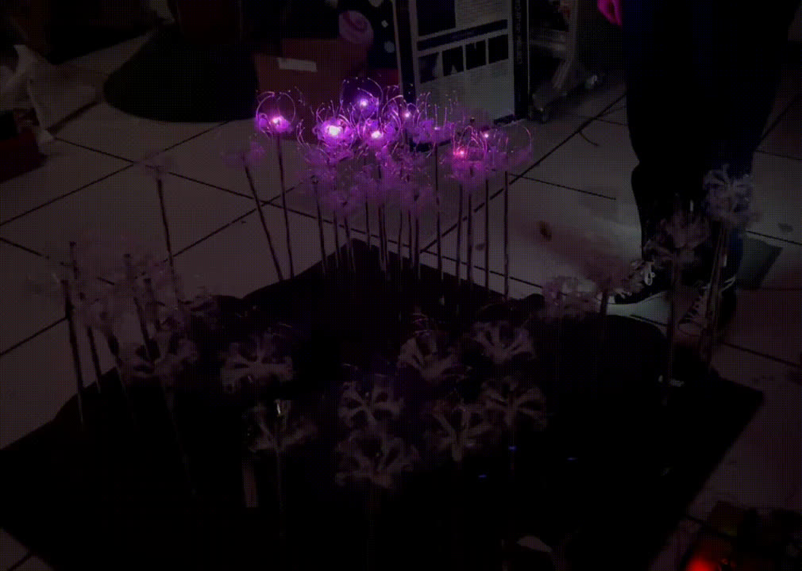
VISUAL EFFECTS - SINELON LIGHTS
Scenario 1
No user stepping on stones
Display Sinelon visual effect, which displays a colored dot sweeping back and forth with fading trails
Scenario 2
User steps on two stone bases
at the same time
Priority will be given to the highest-numbered stone

Slide 25






VISUAL EFFECTS - INTERACTIVE LIGHTS
STONE 1
STONE 2
STONE 3

Slide 26

CONCLUSION

Slide 27

Future works
More development of design aspect
Mechanism to 'bloom' flowers when stepping on pressure sensor
Fan mechanism to mimic wind in the garden
Improving the light component to create more dynamic flower lighting
Improving the light component to create dynamic flower lighting
LED sign board to display title of project and direct users to walk through the pathway

Slide 28
Conclusion
Not an easy task to improve the project
We learnt to delegate tasks and continuously improve our product with various iterations and redesign based on feedback from team members and professors
Through this project,
We hope that people will start to be mindful about their plastic usage and adapt to sustain habits such as Upcycling.

Slide 29


Slide 30


